Slide 1
Management Stephen P. Robbins | Mary Coulter Thirteenth Edition
Chapter 09 Managing Strategy

Slide 2
Learning Objectives
Define strategic management and explain why it’s important.
Explain what managers do during the six steps of the strategic management process.
Know how to identify your own personal strengths and weaknesses and deal with them.
Develop your skill at strategic planning.
Describe the three types of corporate strategies.
Describe competitive advantage and the competitive strategies organizations use to get it.
Discuss current strategic management issues.
© Pearson Education Limited 2016

Slide 3
What Is Strategic Management?
Strategic Management – What managers do to develop the organization’s strategies.
It’s an important task involving all the basic management functions—planning, organizing, leading, and controlling.
Strategies – The plans for how the organization will do what it’s in business to do, how it will compete successfully, and how it will attract and satisfy its customers in order to achieve its goals.
© Pearson Education Limited 2016

Slide 4
What Is Strategic Management?
Business Model – How a company is going to make money. It focuses on two things:
whether customers will value what the company is providing, and
whether the company can make any money doing that.
Amazon: Jeff Bezos pioneered a new business model for selling books to consumers directly online instead of selling through bookstores.
© Pearson Education Limited 2016

Slide 5
Why is strategic management so important?
It results in higher organizational performance. Organizations that use strategic management do have higher levels of performance. And that fact makes it pretty important for managers!
It requires that managers examine and adapt to business environment changes.
They cope with this uncertainty by using the strategic management process to examine relevant factors and decide what actions to take.
It coordinates diverse organizational units, helping them focus on organizational goals.
Each part needs to work together toward achieving the organization’s goals; strategic management helps do this.
© Pearson Education Limited 2016

Slide 6
The Strategic Management Process
The strategic management process is a six-step process that encompasses strategy planning, implementation, and evaluation.
© Pearson Education Limited 2016

Slide 7
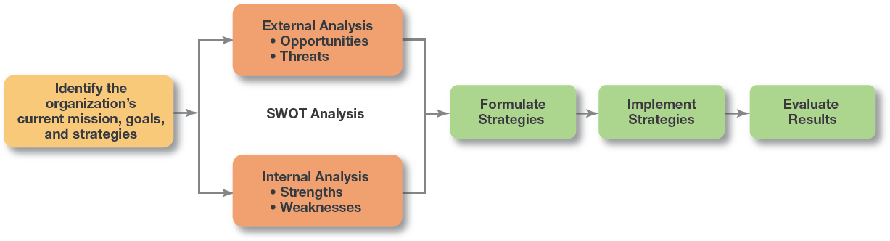
Exhibit 9-1 Strategic Management Process
© Pearson Education Limited 2016

Slide 8
The Strategic Management Process
Step 1: Identifying the organization’s current mission, goals, and strategies:
Mission: a statement of the purpose of an organization.
The scope of its products and services
Goals: the foundation for further planning.
Measurable performance targets
© Pearson Education Limited 2016

Slide 9

The Strategic Management Process
Mission of IQRA University
To be a world-class institution of higher education and research, promoting technical skills, critical thinking and public duty, to help develop a prosperous and progressive society.
© Pearson Education Limited 2016

Slide 10
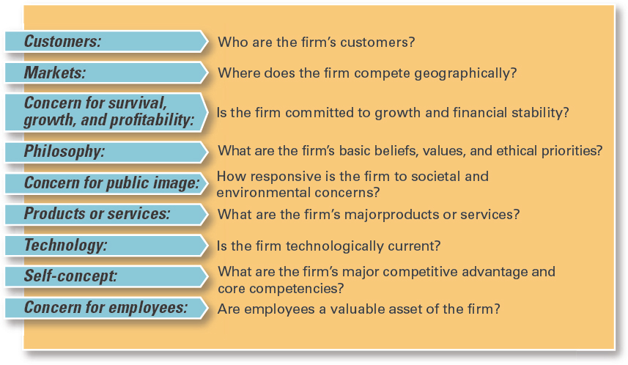
Exhibit 9-2 Components of a Mission Statement
© Pearson Education Limited 2016

Slide 11
The Strategic Management Process
Step 2: Doing an External Analysis
In an external analysis, managers should examine the economic, demographic, political/legal, sociocultural, technological, and global components to see the trends and changes.
Managers need to pinpoint:
Opportunities – positive trends in the external environment that the organization can exploit
Threats - negative trends in the external environment that the organization must counteract or buffer against.
© Pearson Education Limited 2016

Slide 12
The Strategic Management Process
Step 3: Doing an Internal Analysis
It provides important information about an organization’s specific resources and capabilities.
Resources are organization’s assets – financial, physical, human, and intangible—that it uses to develop, manufacture, and deliver products to its customers. They’re “what” the organization has.
Capabilities are organization’s skills and abilities in doing the work activities needed in its business—“how” it does its work.
© Pearson Education Limited 2016

Slide 13
The Strategic Management Process
Core Competencies – The organization’s major value-creating capabilities that determine its competitive weapons.
After doing internal analysis, managers should be able to identify organizational strengths and weaknesses.
Strengths - Any activities the organization does well or any unique resources that it has.
Weaknesses are activities the organization doesn’t do well or resources it needs but doesn’t possess.
© Pearson Education Limited 2016

Slide 14
The Strategic Management Process
The combined external and internal analyses are called the SWOT Analysis, an analysis of the organization’s strengths, weaknesses, opportunities, and threats.
After completing the SWOT analysis, managers are ready to formulate appropriate strategies—that is, strategies that (1) exploit an organization’s strengths and external opportunities, (2) buffer or protect the organization from external threats, or (3) correct critical weaknesses.
© Pearson Education Limited 2016

Slide 15
The Strategic Management Process
Step 4: Formulating Strategies
Develop and evaluate strategic alternatives.
Select appropriate strategies for all levels in the organization that provide relative advantage over competitors.
Match organizational strengths to environmental opportunities.
Correct weaknesses and guard against threats.
© Pearson Education Limited 2016

Slide 16
The Strategic Management Process
Step 5: Implementing strategies
Once strategies are formulated, they must be implemented. No matter how effectively an organization has planned its strategies, performance will suffer if the strategies aren’t implemented properly.
Implementation – Effectively fitting organizational structure and activities to the environment.
© Pearson Education Limited 2016

Slide 17
The Strategic Management Process
Step 6: Evaluating Results
The final step in the strategic management process is evaluating results.
How effective have the strategies been at helping the organization reach its goals?
What adjustments are necessary?
© Pearson Education Limited 2016

Slide 18
Strategies
Organizations use three types of strategies: Corporate, Competitive, and Functional. (See Exhibit 9-3.)
Top-level managers typically are responsible for corporate strategies.
Middle-level managers for competitive strategies.
Lower-level managers for the functional strategies. In this section.
© Pearson Education Limited 2016

Slide 19
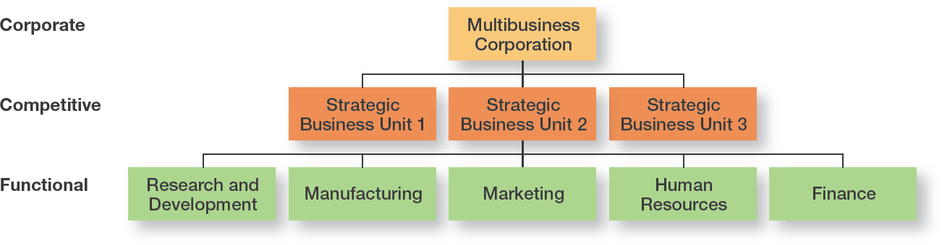
Exhibit 9-3 Types of Organizational Strategies
© Pearson Education Limited 2016

Slide 20
What Is Corporate Strategy?
Corporate Strategy – An organizational strategy that determines what businesses a company is in or wants to be in, and what it wants to do with those businesses.
Strategic Business Unit (SBU) – The single independent businesses of an organization that formulate their own competitive strategies.
© Pearson Education Limited 2016

Slide 21
Types of Corporate Strategy?
The three main types of corporate strategies are growth, stability, and renewal.
Growth – Expansion into new products and markets.
Stability – Maintenance of the status quo.
Renewal – Examination of organizational weaknesses that are leading to performance declines.
© Pearson Education Limited 2016

Slide 22

Growth Strategy
Growth Strategy – A corporate strategy that’s used when an organization wants to expand the number of markets served or products offered, either through its current business(es) or through new business(es).
© Pearson Education Limited 2016

Slide 23
Types of Growth Strategy
1. Concentration focuses on its primary line of business and increases the number of products offered or markets served in this primary business.
Using these three strategies organizations try to compete successfully only within a single industry.
Market Penetration – increasing sales of current products to current market segments without changing the original product
Product Development – offering modified or new products to current market segments
Market Development – identifying and developing new market segments for current company products
© Pearson Education Limited 2016

Slide 24
Types of Growth Strategy
2. Vertical Integration
Backward Vertical Integration – the organization becomes its own supplier so it can control its inputs. For instance, eBay owns PayPal, an online payment business that helps it provide more secure transactions and control one of its most critical processes.
Forward Vertical Integration – the organization becomes its own distributor and is able to control its outputs. For example, Apple has more than 400 retail stores worldwide to distribute its product.
© Pearson Education Limited 2016

Slide 25
Types of Growth Strategy
3. Horizontal Integration – a company grows by combining with competitors.
For instance, French cosmetics giant L’Oreal acquired The Body Shop in 2006 till 2017. In June 2017, L'Oréal agreed to sell the company to Natura for £880 million. The deal was approved in September 2017.
Horizontal integration has been used in a number of industries in the last few years—financial services, consumer products, airlines, department stores, and software, among others.
© Pearson Education Limited 2016

Slide 26
Types of Growth Strategy
4. Diversification – starting up or acquiring businesses outside the company’s current products and markets.
Related diversification – When a company combines with other companies in different, but related industries. For example, Google has acquired a number of businesses (some 150 total), including YouTube, DoubleClick, Nest, and Motorola Mobility.
Unrelated diversification – When a company combines with firms in different and unrelated industries. For instance, the Tata Group of India has businesses in chemicals, communications and IT, consumer products, energy, engineering, materials, and services.
© Pearson Education Limited 2016

Slide 27
Stability Strategy
A stability strategy is a corporate strategy in which an organization continues to do what it is currently doing.
Examples:
Continuing to serve the same clients by offering the same product or service
Maintaining market share
Sustaining the organization’s current business operations
© Pearson Education Limited 2016

Slide 28
Renewal Strategy
Renewal Strategies – When an organization is in trouble, something needs to be done. Managers need to develop strategies, that address declining performance.
The two main types of renewal strategies are:
Retrenchment Strategy – a short-run renewal strategy used for minor performance problems.
Turnaround Strategy – When an organization’s problems are more serious, more drastic action is needed.
© Pearson Education Limited 2016

Slide 29
How Are Corporate Strategies Managed?
BCG matrix – A strategy tool that guides resource allocation decisions on the basis of market share and growth rate of SBUs.
It was developed by the Boston Consulting Group
An organization’s various businesses could be evaluated and plotted using a 2 × 2 matrix to identify which ones offered high potential and which were a drain on organizational resources.
© Pearson Education Limited 2016

Slide 30
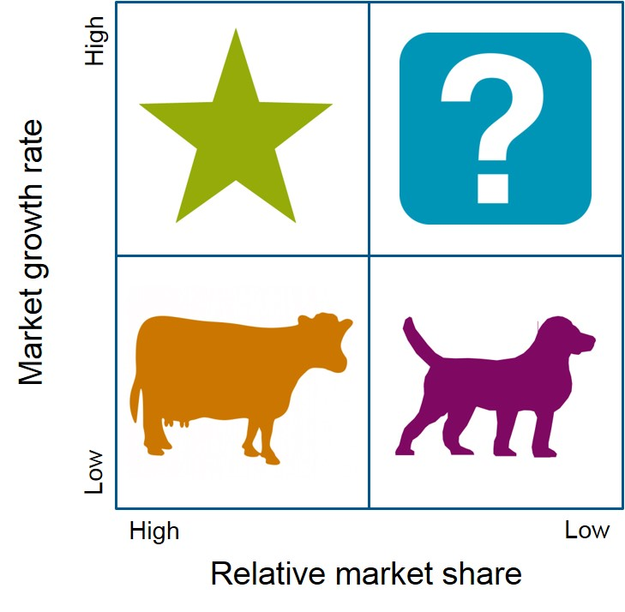
How Are Corporate Strategies Managed?
Stars: High market share/High anticipated growth rate
Cash Cows: High market share/Low anticipated growth rate
Question Marks: Low market share/High anticipated growth rate
Dogs: Low market share/Low anticipated growth rate
© Pearson Education Limited 2016

Slide 31
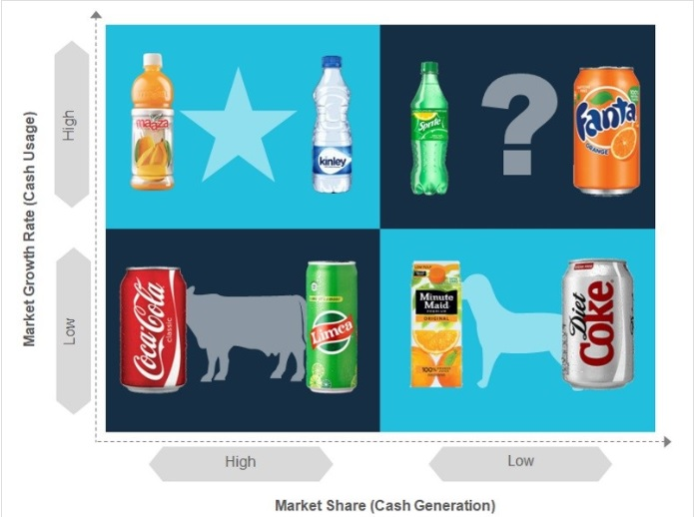
BCG Matrix - Example
© Pearson Education Limited 2016

Slide 32
Strategic Implications Of The BCG Matrix?
The dogs should be sold off or liquidated as they have low market share in markets with low growth potential.
Managers should “milk” cash cows for as much as they can, limit any new investment in them, and use the large amounts of cash generated to invest in stars and question marks with strong potential to improve market share.
Heavy investment in stars will help take advantage of the market’s growth and help maintain high market share. The stars, of course, will eventually develop into cash cows as their markets mature and sales growth slows.
After careful analysis, some question marks will be sold off and others strategically nurtured into stars.
© Pearson Education Limited 2016

Slide 33
Competitive Strategy
Competitive Strategy – An organizational strategy for how an organization will compete in its business(es).
Example: LVMH-Moët Hennessy Louis Vuitton SA has different competitive strategies for its businesses, which include Donna Karan fashions, Louis Vuitton leather goods, Guerlain perfume, TAG Heuer watches, Dom Perignon champagne, and other luxury products.
Strategic Business Unit (SBU) – The single independent businesses of an organization that formulate their own competitive strategies.
© Pearson Education Limited 2016

Slide 34
The Role of Competitive Advantage
Competitive Advantage – What sets an organization apart; its distinctive edge. That distinctive edge can come from the organization’s core competencies by doing something that others cannot do or doing it better than others can do it.
Apple has created the world’s best and most powerful brand using innovative design and merchandising capabilities
The Ritz Carlton hotels have a unique ability to deliver personalized customer service
Walmart’s state-of-the-art information system allows it to monitor and control inventories and supplier relations more efficiently than its competitors
© Pearson Education Limited 2016

Slide 35
The Role of Competitive Advantage
Quality as a Competitive Advantage – If a business is able to continuously improve the quality and reliability of its products, it may have a competitive advantage that can’t be taken away.
Design Thinking as a Competitive Advantage – A company’s ability to use design thinking in the way its employees and managers strategically manage can be a powerful competitive tool.
Social Media as a Competitive Advantage – Successful social media strategies should (1) help people connect; and (2) reduce costs or increase revenue possibilities or both.
© Pearson Education Limited 2016

Slide 36
Sustaining Competitive Advantage
Not every organization is able to effectively exploit its resources and to develop the core competencies that can provide it with a competitive advantage. And it’s not enough simply to create a competitive advantage.
The organization must be able to sustain that advantage; that is, to keep its edge despite competitors’ actions or evolutionary changes in the industry.
By using strategic management, managers can better position their organizations to get a sustainable competitive advantage.
© Pearson Education Limited 2016

Slide 37
Five Forces Model
Michael Porter explained how managers can create a sustainable competitive advantage. These five forces determine industry attractiveness and profitability
Threat of new entrants: How likely is it that new competitors will come into the industry?
Threat of substitutes: How likely is it that other industries’ products can be substituted for our industry’s products?
Bargaining power of buyers: How much bargaining power do buyers (customers) have?
Bargaining power of suppliers: How much bargaining power do suppliers have?
Current rivalry: How intense is the rivalry among current industry competitors?
© Pearson Education Limited 2016

Slide 38
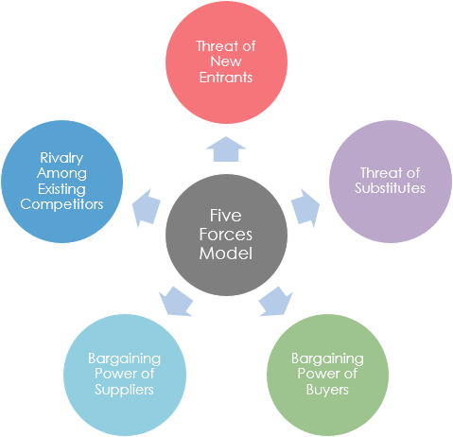
Michael’s Five Forces Model
© Pearson Education Limited 2016

Slide 39
Choosing a Competitive Strategy
Cost Leadership Strategy – When an organization competes on the basis of having the lowest costs (costs or expenses, not prices) in its industry.
Differentiation Strategy – A company that competes by offering unique products that are widely valued by customers.
Focus Strategy – Involves a cost advantage (cost focus) or a differentiation advantage (differentiation focus) in a narrow segment or niche.
Stuck in the Middle – When costs are too high to compete with the low-cost leader or when its products and services aren’t differentiated enough to compete with the differentiator.
© Pearson Education Limited 2016

Slide 40
Functional Strategy
Functional Strategy – The strategies used by an organization’s various functional departments to support the competitive strategy.
© Pearson Education Limited 2016

Slide 41
Review Learning Objective 9.1
Define strategic management and explain why it’s important.
Strategies are the plans for how the organization will do whatever it’s in business to do, how it will compete successfully, and how it will attract and satisfy its customers in order to achieve its goals.
A business model is how a company is going to make money.
© Pearson Education Limited 2016

Slide 42
Review Learning Objective 9.2
Explain what managers do during the six steps of the strategic management process.
Identify the current mission, goals, and strategies.
Do an external analysis.
Do an internal analysis (steps 2 and 3 collectively are known as SWOT analysis).
Formulate strategies.
Implement strategies.
Evaluate strategies.
© Pearson Education Limited 2016

Slide 43
Review Learning Objective 9.2
Weaknesses – Activities the organization doesn’t do well or resources it needs.
Opportunities are positive trends in the external environment.
Strengths – Any activities the organization does well or its unique resources.
Threats are negative trends.
© Pearson Education Limited 2016

Slide 44
Review Learning Objective 9.3
Describe the three types of corporate strategies.
Growth strategy – When an organization expands the number of markets served or products offered, either through current or new businesses.
Concentration, vertical integration (backward and forward), horizontal integration, and diversification (related and unrelated).
Stability strategy – When an organization makes no significant changes in what it’s doing.
Renewal strategies—retrenchment and turnaround – Address organizational weaknesses leading to performance declines.
© Pearson Education Limited 2016

Slide 45
Review Learning Objective 9.3
The BCG matrix is a way to analyze a company’s portfolio of businesses by looking at a business’s market share and its industry’s anticipated growth rate. The four categories of the BCG matrix are:
Cash cows
Stars
Question marks
Dogs
© Pearson Education Limited 2016

Slide 46
Review Learning Objective 9.4
Describe competitive advantage and the competitive strategies organizations use to get it.
Competitive advantage is what sets an organization apart, its distinctive edge.
Porter’s five forces model assesses the five competitive forces that dictate competition in an industry:
Threat of new entrants, threat of substitutes, bargaining power of buyers, bargaining power of suppliers, and current rivalry
© Pearson Education Limited 2016

Slide 47
Review Learning Objective 9.4
Porter’s three competitive strategies are as follows:
Cost leadership (competing on the basis of having the lowest costs in the industry).
Differentiation (competing on the basis of having unique products that are widely valued by customers).
Focus (competing in a narrow segment with either a cost advantage or a differentiation advantage).
© Pearson Education Limited 2016

